Slide 1
GitHub Project
Hotel Booking Demand analysis

Slide 2
GitHub Project Details
DataSet : Hotel Booking demand
https://www.kaggle.com/datasets/jessemostipak/hotel-booking-demand/data
Date
January 13 2024
Team Members
Konstantina Drakonaki
Maria Vasileiadou
Eirini Nterou

Slide 3
Dataset Cleaning
Check data
Number of rows
Number of Columns and Types
Nulls
Remove Nulls for country
Drop Duplicates & Reset Index
Correct date types

Slide 4
Data Analysis
Cancellation of Reservation Analysis:
Per Country
Per Market Segment
Per Hotel type
Per leadtime
Price Analysis:
Per Month
Per Hotel type
Reservation Analysis:
Per Month
Per Market Segment
Country
Per Room Type (which type of rooms are most popular)

Slide 5
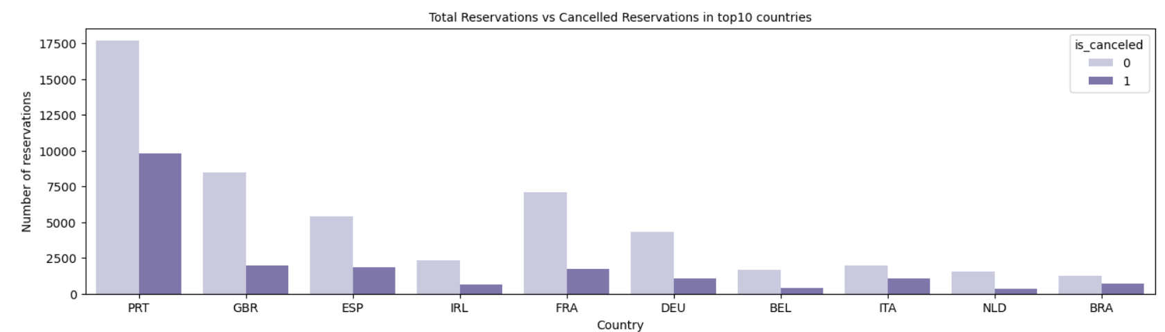
Cancellation Analysis Per Country (Top 10 Countries)

Slide 6
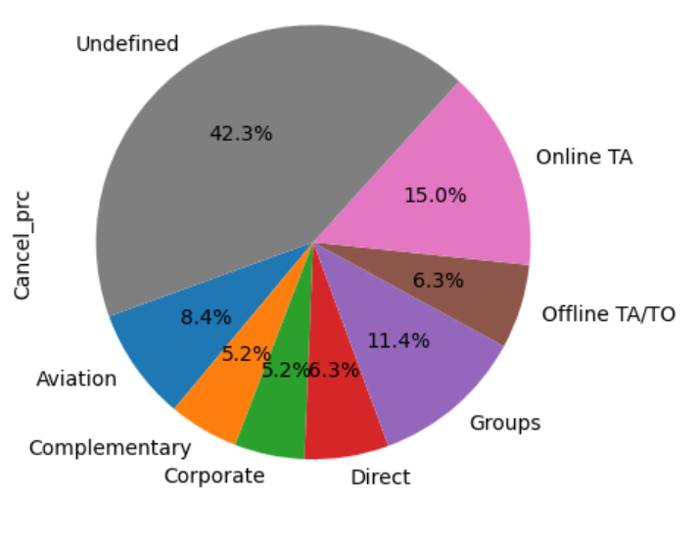
Cancellation Analysis Per Market Segment

Slide 7
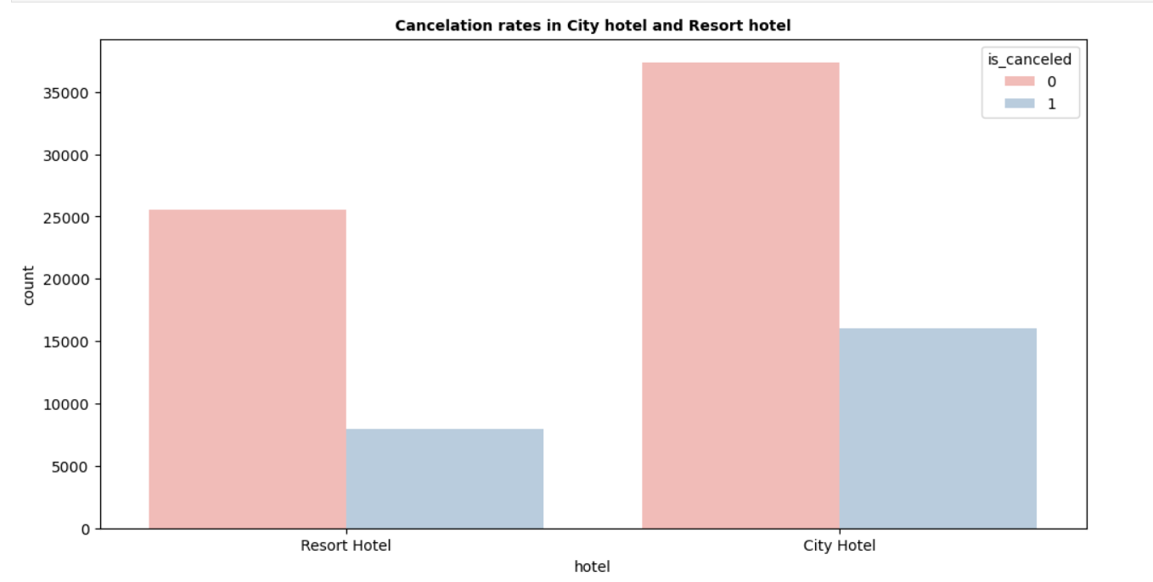
Cancellation Analysis Per Hotel type

Slide 8
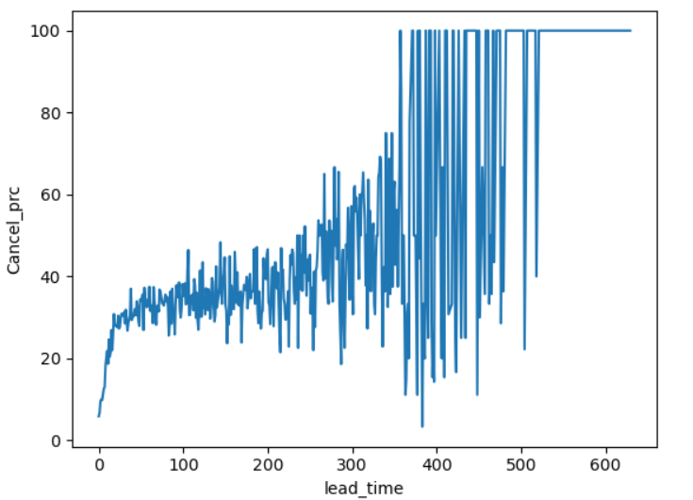
Cancellation Analysis Per Lead Time

Slide 9
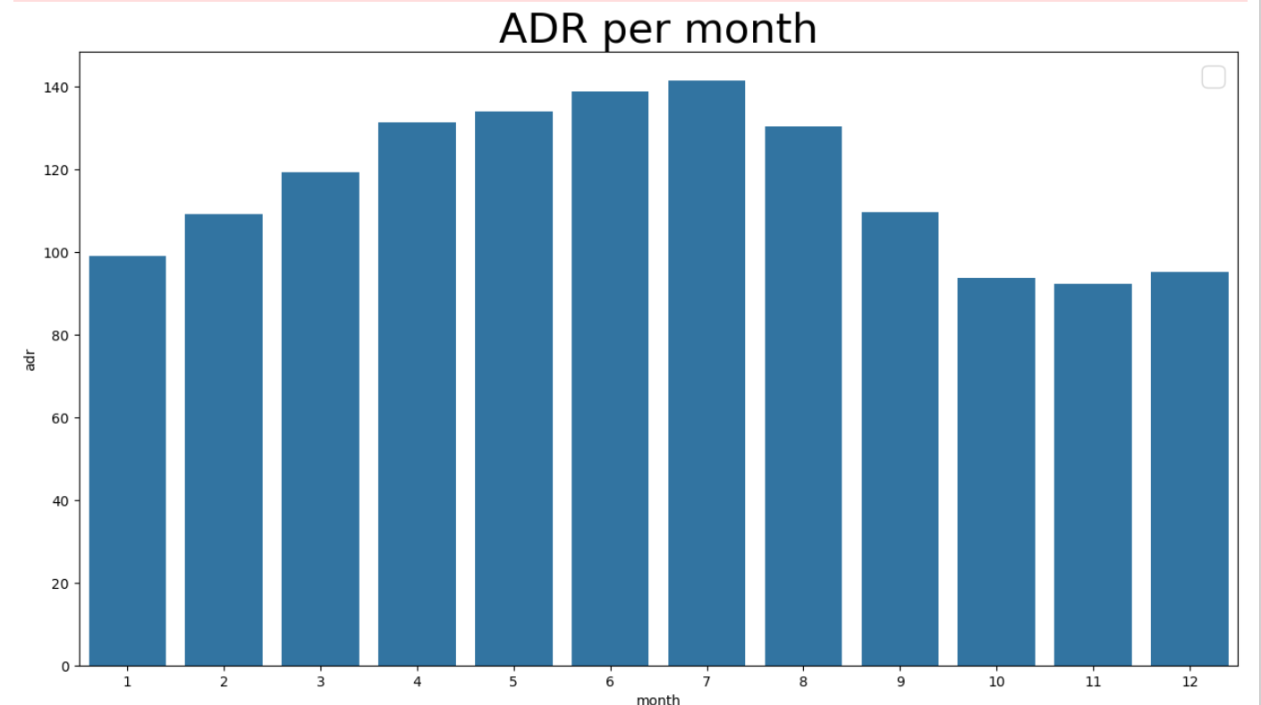
Price Analysis Per Month

Slide 10
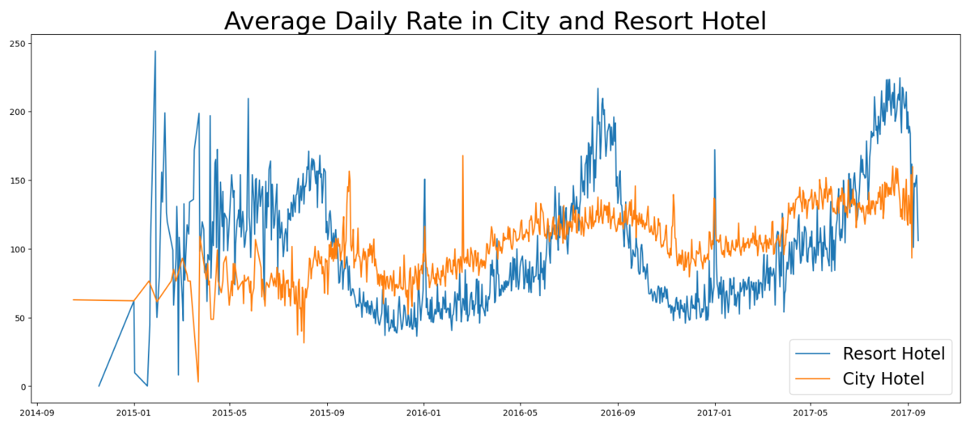
Price Analysis Average Rate Evolution per Hotel Type

Slide 11
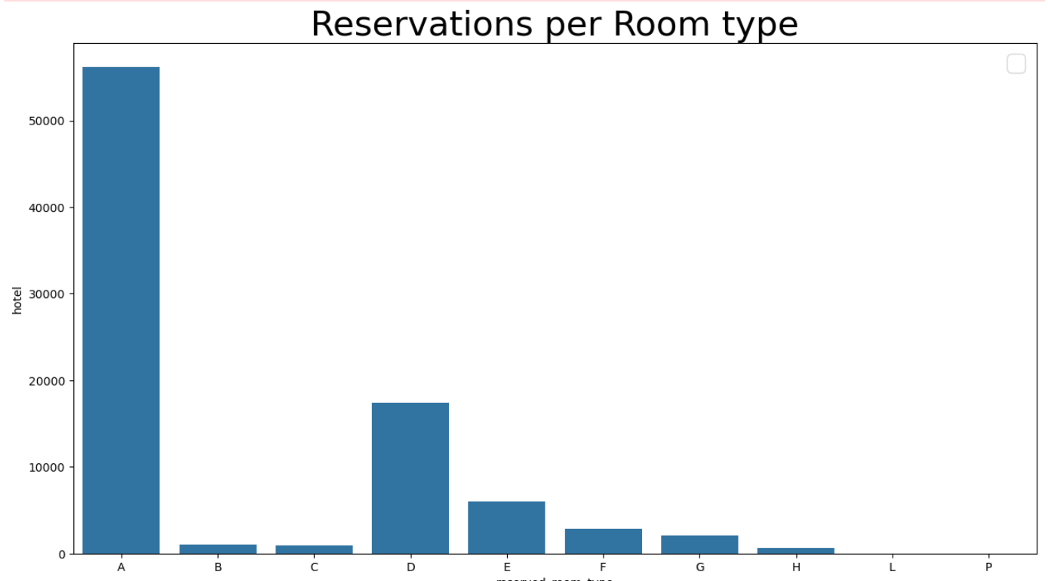
Reservation Analysis Per Room Type

Slide 12
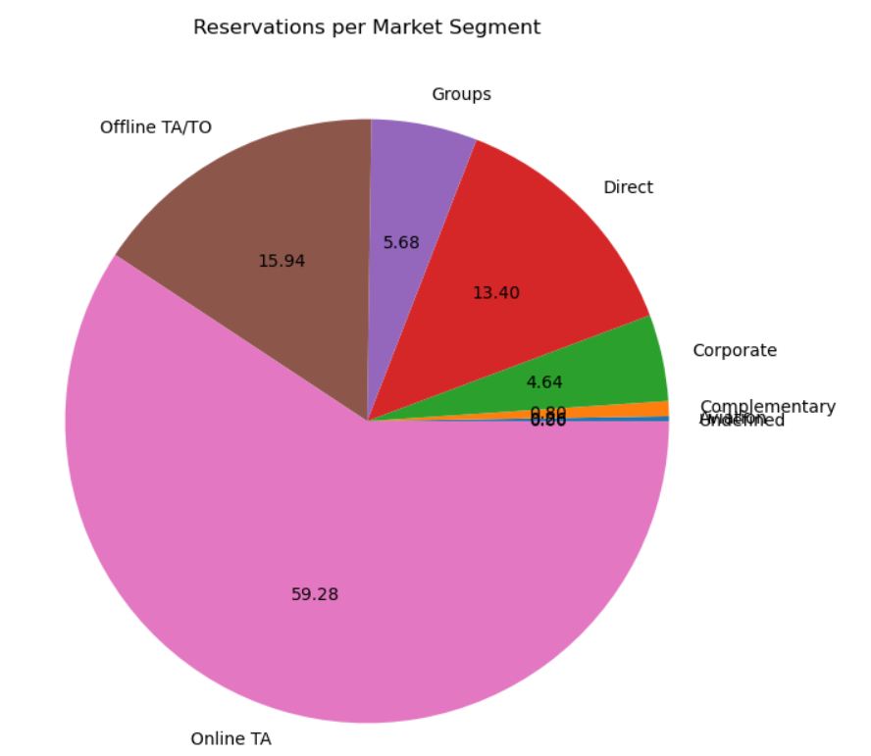
Reservation Analysis Per Market Segment

Slide 13
Data Analysis Outcomes
Cancellation of Reservation Analysis:
Countries with lower cancellation percentage are GBR, IRL, BEL, IRL
Cancellation percentage is higher for Online TA and Groups
Resort Hotels have lower cancellation rate vs City Hotels
For lead time over 50 days, cancellation chances are higher
Price Analysis:
The average daily rate is higher from April – August
The average rate evolution is smoother for city hotels
Increases in average rate are identified on September 2016 & 2017
Reservation Analysis:
Most reservations take place from Online TAs
Room type A and D are more popular

